Slide 1
What’s in the Duckiebox and how does it work?

Slide 2
What’s in the box and how does it work?
Content of the Duckiebox
Functionality of each Duckiebot component
Operational fundamentals
A Duckiebox
Jacopo Tani (ETHZ) – first version – 9/22/17
Author name (affiliation) - second version, another date

Slide 3
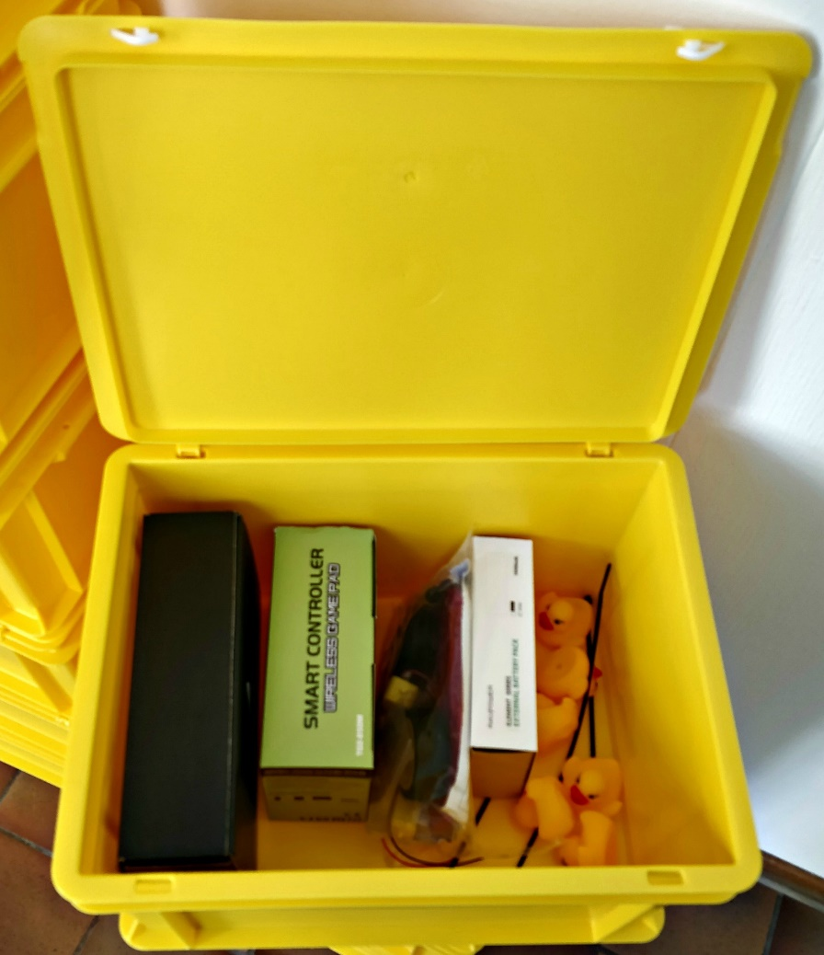
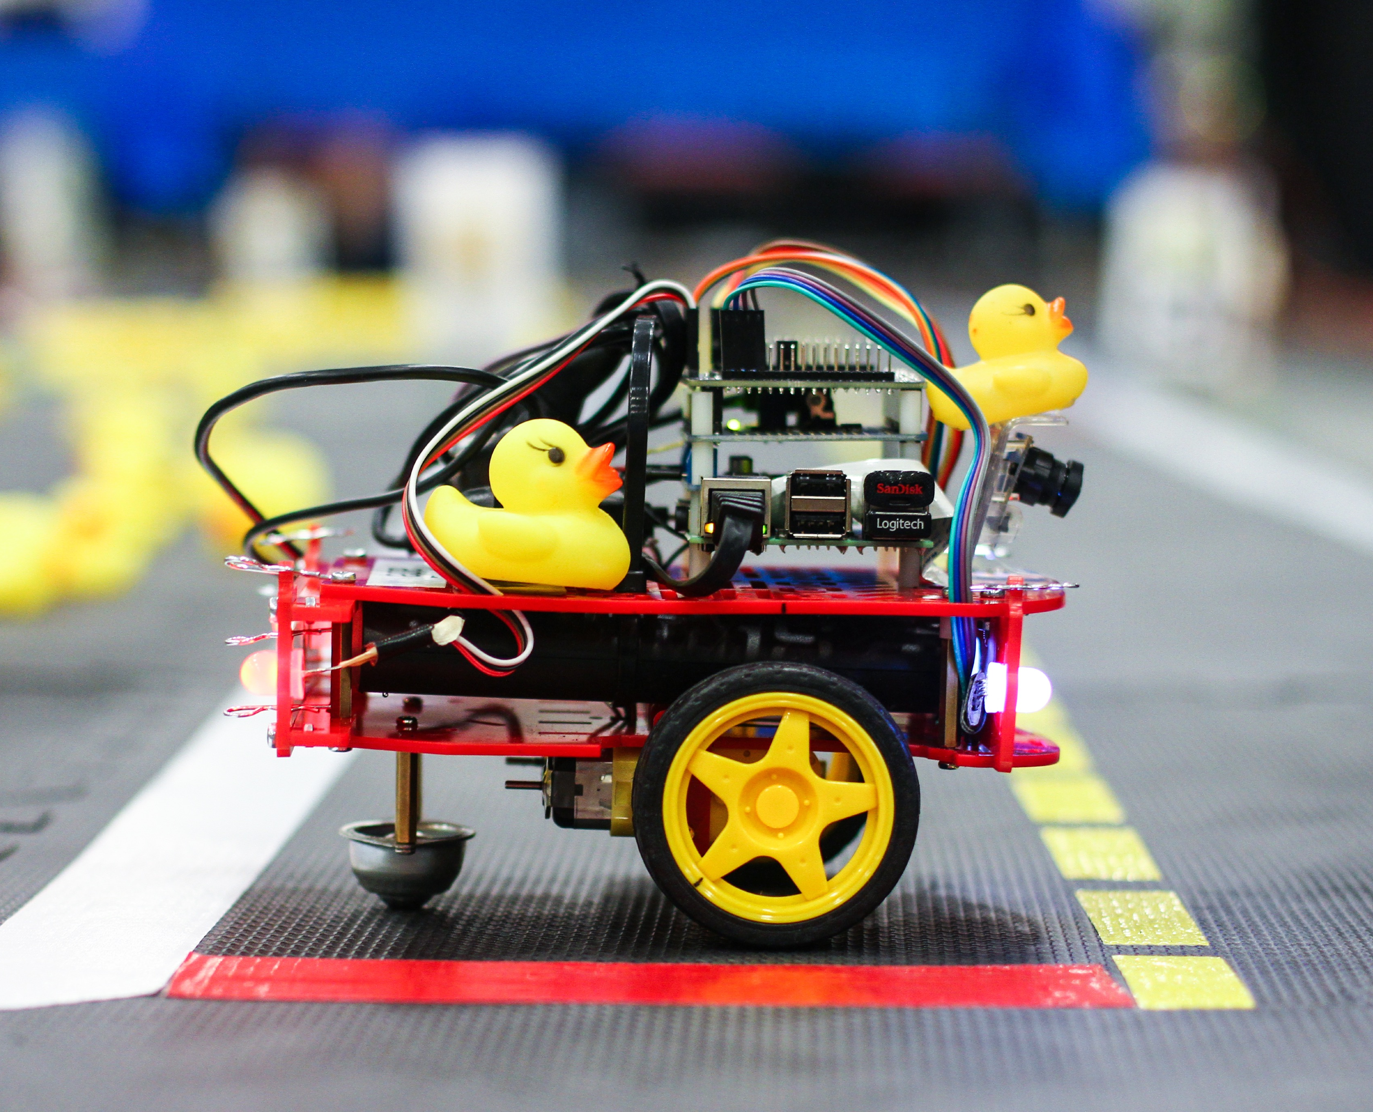

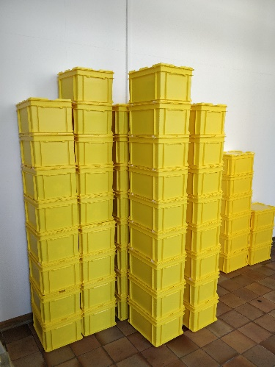
Goal
The Duckiebox
The Duckiebot
(in configuration DB17-wjd)

Slide 4
Duckiebot
Computation + Memory
Duckies
Sensing
Energy
Actuation

Slide 5

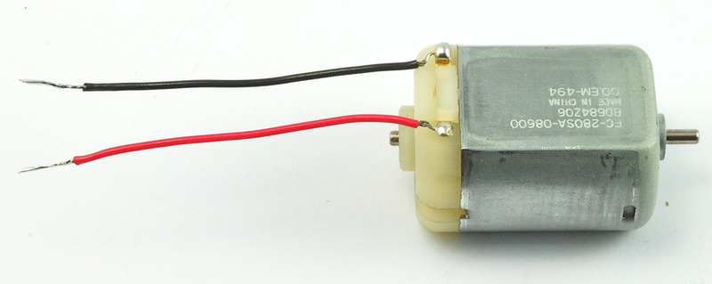
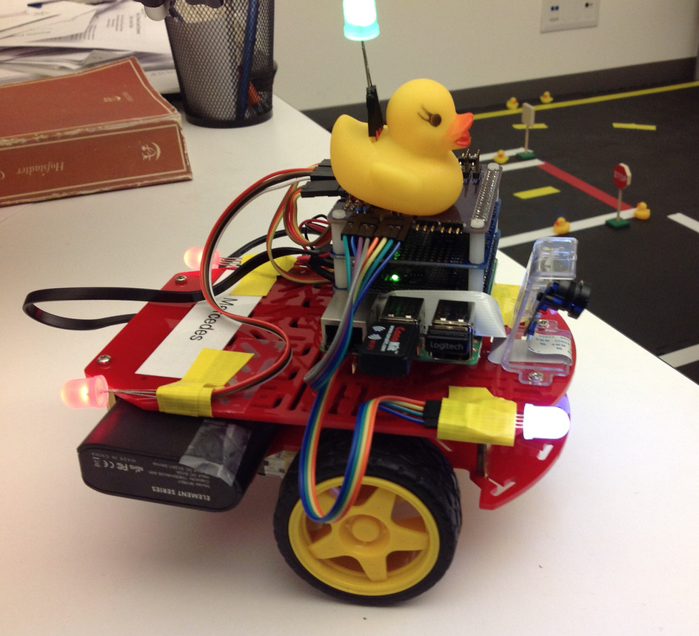

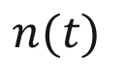
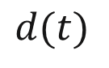
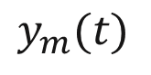
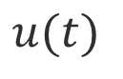
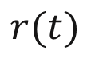
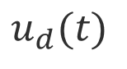
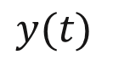
High-level overview
Disturbances
$$d(t)$$
Measurement noise
$$n(t)$$
Controller
Actuator
$$r(t)$$
$$u_{d}(t)$$
$$u(t)$$
$$y(t)$$
$$y_{m}(t)$$
Reference
path
Desired plant input
Input
Output
Measurement
Plant
Sensor

Slide 6
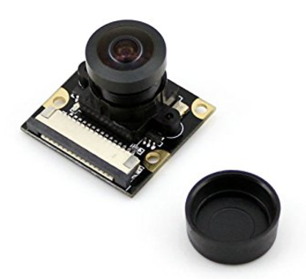
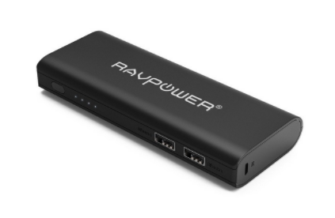
Controller
Actuator
Sensor
Memory
Computation
Energy

Slide 7
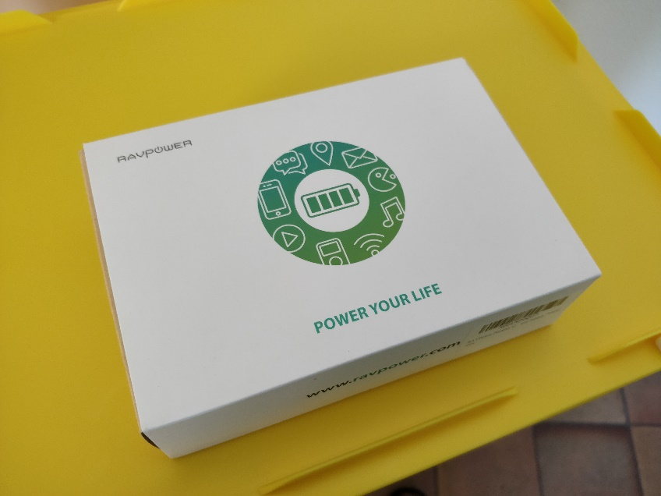
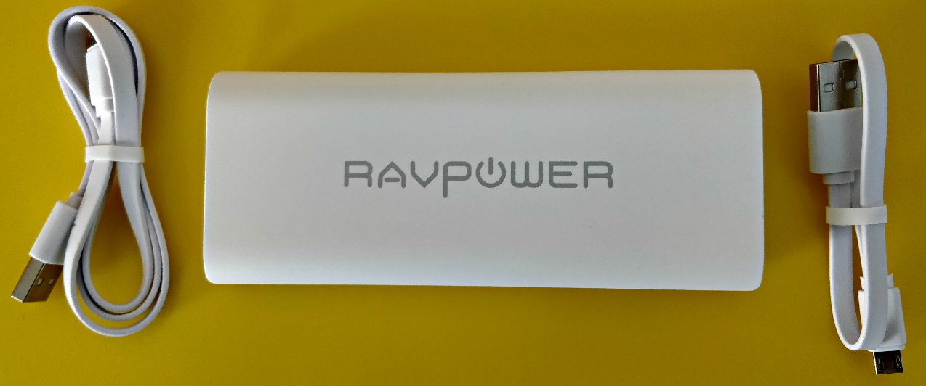
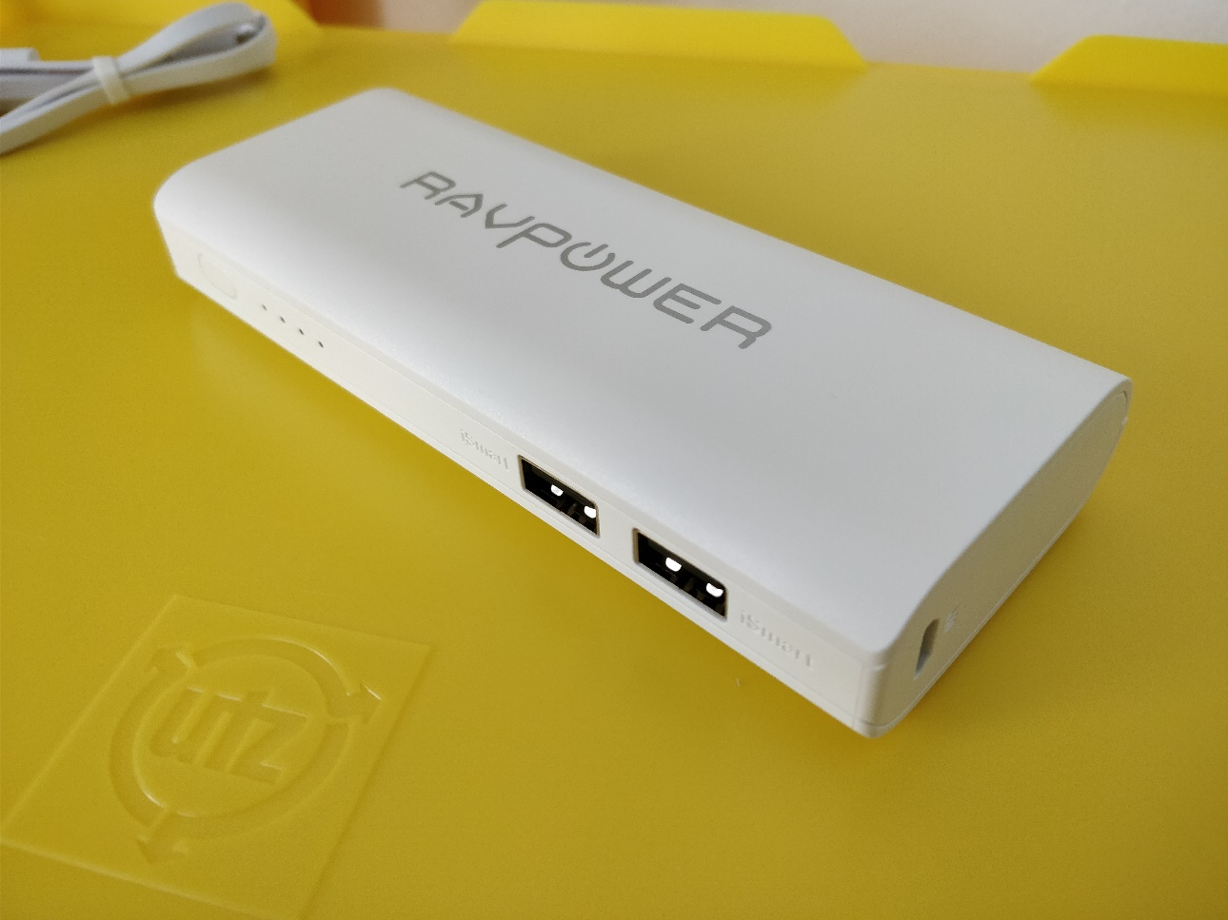
Battery Pack
On/Off (keep pressed) button
Battery Pack:
Battery
Long USB cable
Short USB cable
Input (charge)
Charge Indicator
Battery:
Capacity: 10400 mAh
2 outputs @ 4.5 A max (combined)
Input charge @ 2 A
Output (to Raspberry PI and DC Motor HAT)

Slide 8
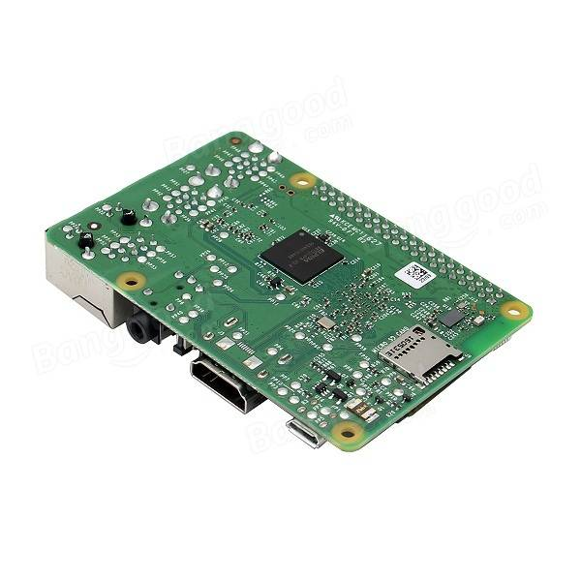

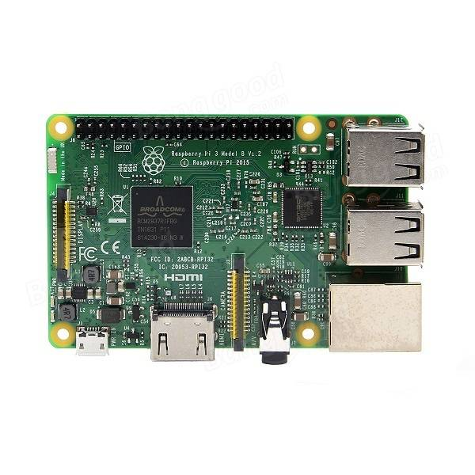
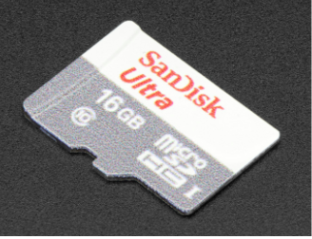
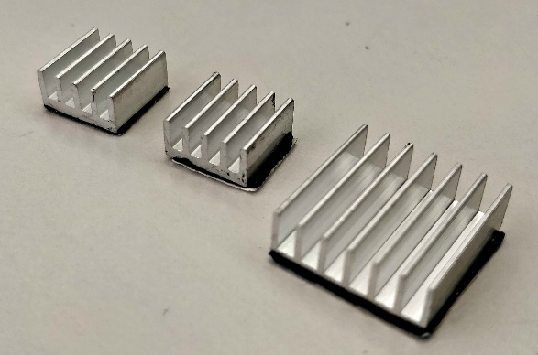
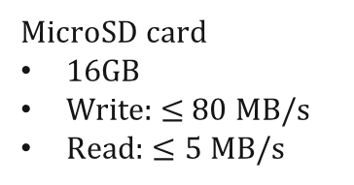
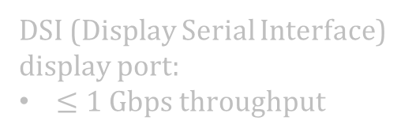
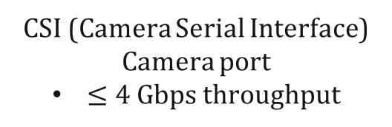
Computation and Memory
Broadcom BCM2837
CPU: 4xARM Cortex-A53, 1.2 GHz
64 bit
1GB LPDDR2 RAM (900 MHz)
GPU: Broadcom VideoCore IV
40 Pin GPIO
(General Purpose Input/Output)
LAN controller
MicroSD card slot
Bluetooth 4.1 Wi-Fi
2.4 GHz, 802.1n
USB ports
DSI (Display Serial Interface) display port:
$≤1$ Gbps throughput
MicroSD card
16GB
Write: $≤$80 MB/s
Read: $≤5$ MB/s
LAN port
Power input
up to 2.5A
HDMI output
Composite video and audio output
CSI (Camera Serial Interface) Camera port
$≤4$ Gbps throughput
Heat Sinks

Slide 9
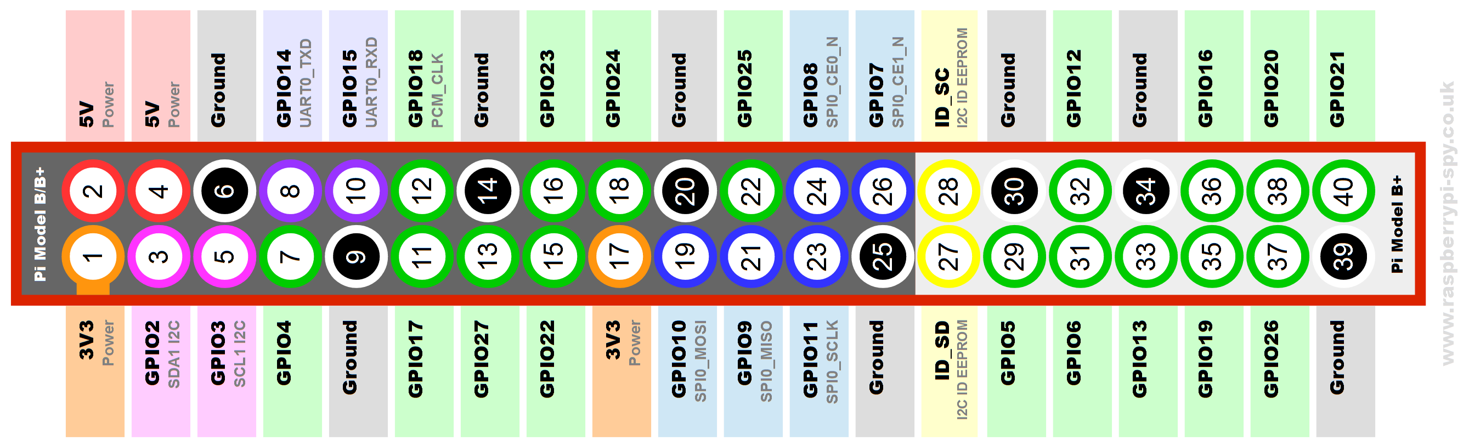
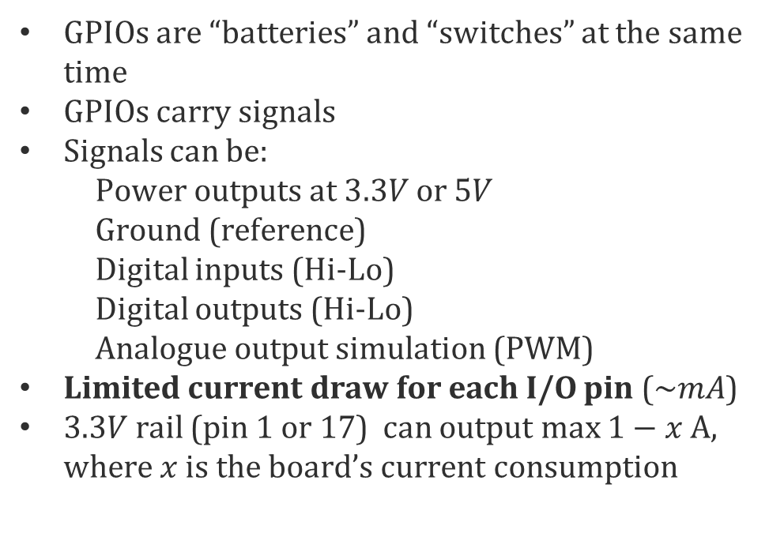
Computation and Memory: I/Os
Control signal to wheels*
GPIOs are “batteries” and “switches” at the same time
GPIOs carry signals
Signals can be:
Power outputs at $3.3V$ or $5V$
Ground (reference)
Digital inputs (Hi-Lo)
Digital outputs (Hi-Lo)
Analogue output simulation (PWM)
Limited current draw for each I/O pin ($\sim mA$)
$3.3V$ rail (pin 1 or 17) can output max $1−x$ A, where $x$ is the board’s current consumption
Wi-Fi
Power
(from battery)
Images
Power consumption figures
Version | Input | Max. total USB draw | Bare board active current consumption (typical) | Camera
3B 1.2 | 2.5A | 1.2A | 400-750 mA | 250 mA

Slide 10
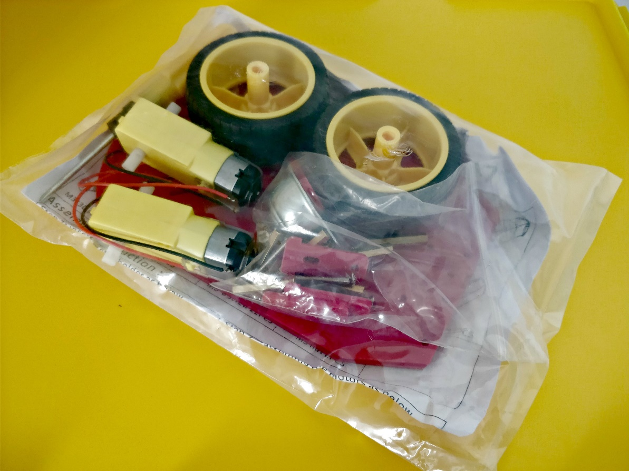
Chassis Package
Chassis
2x Wheels
1x Omnidirectional (castor) wheel
Mechanical bits (keep the ones you don’t use!)
Standoffs
Screws
Nuts
2x DC motors: Differential drive, each motor independently drives a wheel
1x Screwdriver

Slide 11
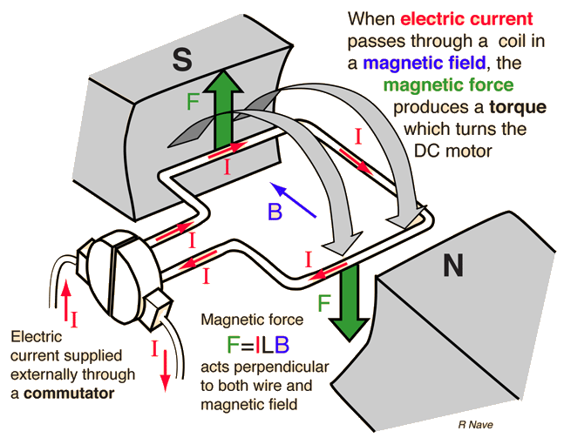
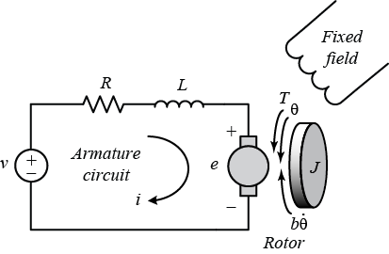
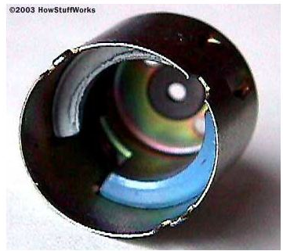
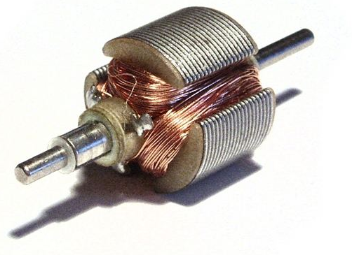
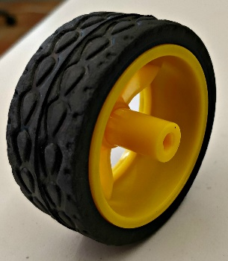
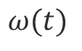
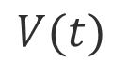
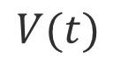
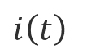
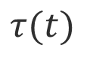
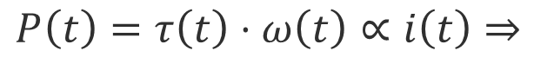
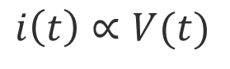
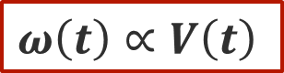

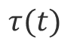
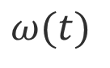
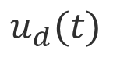
DC Motor
High level:
$$u_{d}(t)$$
$$u(t)$$
Desired plant input
Actual plant input
$$τ(t)$$
$$V(t)$$
$$i\left(t\right)$$
$$ω(t)$$
Mid level:
$$V(t)$$
$$i\left(t\right)∝V(t)$$
$$τ(t)$$
$$ω(t)$$
Current
Torque
Angular velocity
Stator
Rotor
$$P\left(t\right)=τ\left(t\right)⋅ω\left(t\right)∝i\left(t\right)⇒$$
$$ω\left(t\right)∝V\left(t\right)$$

Slide 12
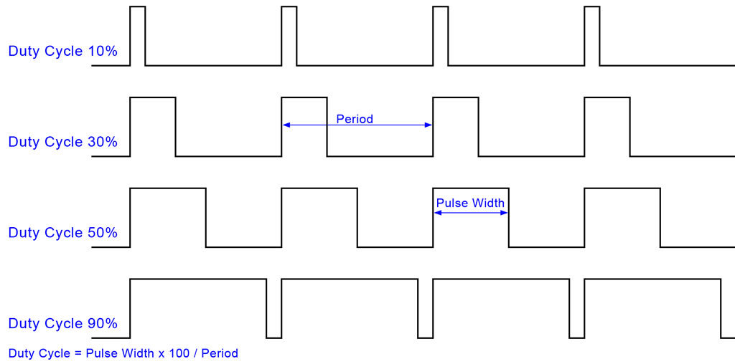
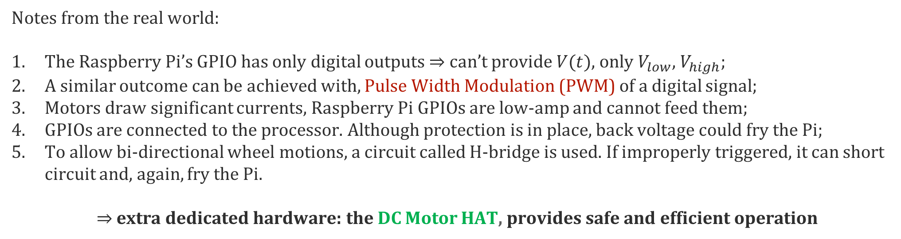
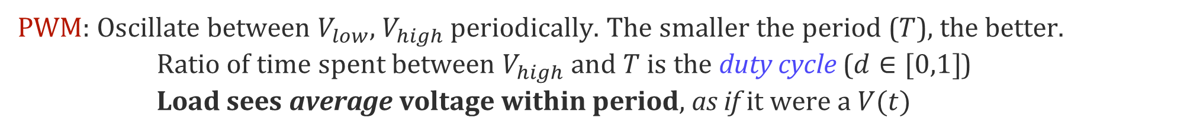
DC Motor – Low level considerations
Notes from the real world:
The Raspberry Pi’s GPIO has only digital outputs $⇒$ can’t provide $V(t)$, only $V_{low}$, $V_{high}$;
A similar outcome can be achieved with, Pulse Width Modulation (PWM) of a digital signal;
Motors draw significant currents, Raspberry Pi GPIOs are low-amp and cannot feed them;
GPIOs are connected to the processor. Although protection is in place, back voltage could fry the Pi;
To allow bi-directional wheel motions, a circuit called H-bridge is used. If improperly triggered, it can short circuit and, again, fry the Pi.
$⇒$ extra dedicated hardware: the DC Motor HAT, provides safe and efficient operation
PWM: Oscillate between $V_{low}$, $V_{high}$ periodically. The smaller the period ($T$), the better.
Ratio of time spent between $V_{high}$and $T$ is the duty cycle ($d∈[0,1]$)
Load sees average voltage within period, as if it were a $V(t)$
+ It is easy to build switches (transistors) that do this;
+ It is more power efficient than using an analogue signal
- The PWM frequency must not interfere with the natural dynamics of the controlled load

Slide 13
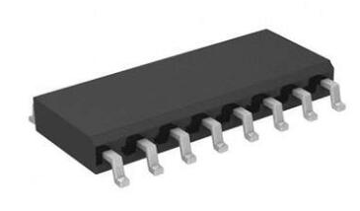
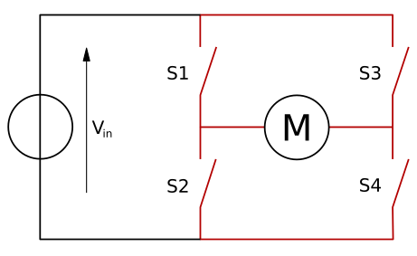
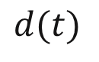
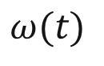

DC Motor – Low level
I2C bus
DC Motor HAT
Data (SDA)
Clock (SCL)
$$d(t)$$
$$V(t)$$
$$ω(t)$$
3.3V
Ground (reference)
PWM chip
H-bridge
(motor driver)
Power for the motors
Power for the RPI and periphericals

Slide 14


DC Motor HAT
PWM chip
GPIO extension
Each motor can draw $≤1.2$ A @ $5.5−13.5 VDC$
$5−12$ VDC input
PWM: 8-bit resolution $(\sim 0.5\%)$
Motor Drivers
(H-Bridge)
Motor wires terminal
connectors
Polarity protection FET
Power from battery
schematics

Slide 15




Camera
Power outputs
CSI port
300 mm (long) camera cable
Camera Mount
Fisheye lens (${160}^{∘}$ Field of view)
5 MP OV5647 sensor
Max resolution: $2592×1944$
1-30 fps @ $1920×1080$
CCD size:$1/4′′$
$1.4 μm×1.4 μm$ pixel size
Provides $3.3 V$ power output
Rolling shutter
S/N ratio: $36 dB$
Dynamic Range: $67 dB @ 8$x gain
ProTip: Remove cover before use!

Slide 16





Tools
Universal to CH adapter
Raspberry Pi charger (2.5A)
MicroSD card reader
Zipties
Screwdriver

Slide 17

Duckies
A Duckiebot must have at least one Duckie on board

Slide 18


5 GHz wireless adapter: the “Edimax”
Provides high-speed $(≤866 Mbps)$ Wi-Fi LAN
Great for communicating with laptop and streaming images

Slide 19


2.4 GHz wireless joypad
Remote control of the Duckiebot
Map functions to buttons during development
Reminder 1: insert batteries
Reminder 2: hardware on/off switch on the back
USB Dongle
USB Dongle

Slide 20


External USB drive
32 GB
Read: $≤150 MBs$

Slide 21

Configurations definition
Let the following hardware be considered “optional”, and be characterized by ($⋅$):
5 Ghz Wi-Fi adapter “Edimax” (w);
Wireless joypad (j);
External USB drive (d).
The configuration of a Duckiebot is represented by the following notation: DB17-`optional`
`optional` is any of ($⋅$), in any order.
Examples:
Duckiebot with USB drive, but no wireless adapter: DB17-d
Duckiebot with all optional hardware components: DB17-wjd
Duckiebot with Edimax adapter and joypad, but no USB drive: DB17-jw

Slide 22
Organization of the lectures/ repo.
0_drafts/: anything goes here. Feel free to make subfolders.
1_beta/: put things here that must be reviewed by others.
2_given/:
when you give the lecture, save it here with the timestamp and the name of the location.
Also save a .pdf version.
These timestamped .key and .pdf files are the ones to be linked to from the class page
These files are never modified after they are timestamped.
3_ideal/: later, here we will assemble the “ideal” version of the slides.

Slide 23
Getting the URL to share
Go to Github, click on the file.
On the file page, copy the link that is on the Download button.
They look like this:
https://github.com/duckietown/lectures/raw/master/duckietown-master.pdf
https://github.com/duckietown/lectures/raw/master/duckietown-master.key

